Slide 1
GaMS – Building Slovene LLM
Domen Vreš
Head developer of the model
Ljubljana, 15. 6. 2026

Slide 2
What is GaMS
Generative Model for Slovene
Open-source LLM for Slovene
  PoVeJMo research project
Middle sized – efficient
All GaMS models are avaiable on HF under CJVT:
  https://huggingface.co/cjvt/collections
You can test the model online:
  https://povejmo.si/klepet/
  https://arena.cjvt.si/sl

Slide 3
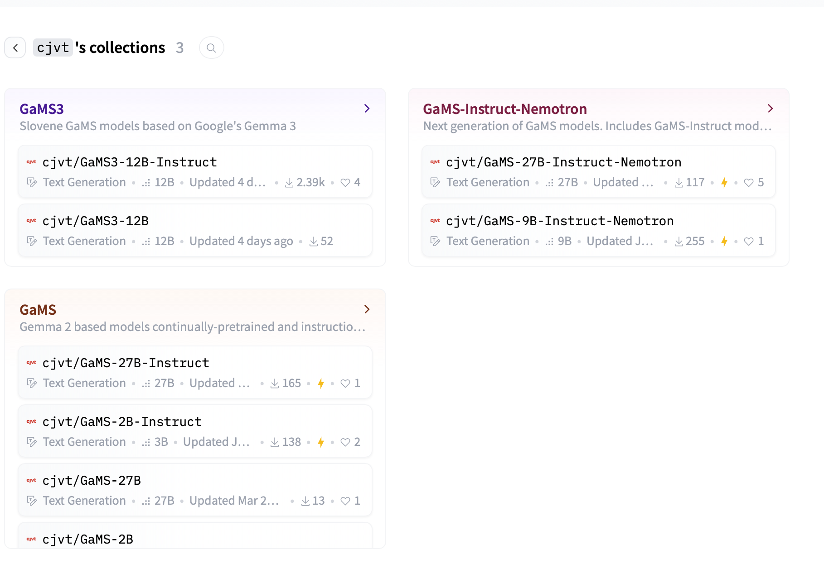

Slide 4


Slide 5
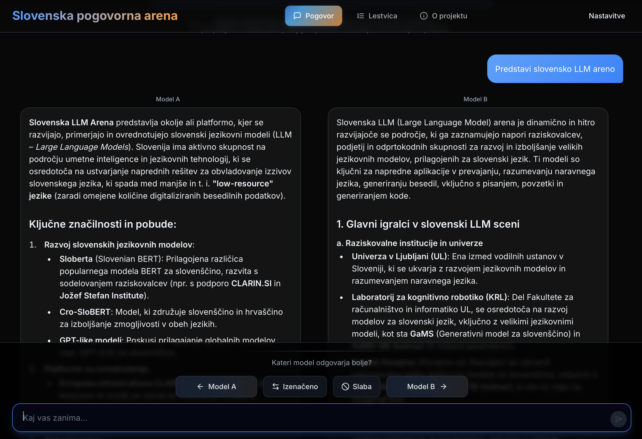

Slide 6
Why?
Master of your data
Transparency
Independence
EU regulations
Dealing with sensitive data
  Healthcare
  Government
  …

Slide 7
GaMS
Based on Google’s Gemma
GaMS-9B, GaMS-27B
  Based on Gemma 2
  GaMS-Instruct-Nemotron versions perform best
  Context: 8k tokens (5k words)
GaMS3-12B
  Based on Gemma 3
  Context: 131k tokens (80k words) – efficient up to 65k tokens
  Multimodal version

Slide 8
GaMS - capabilities
Slovenian-LLM-Eval
Models are ranked from 1 (best) to 10 (worst) based on accuracy on each benchmark
Table: Average across all benchmarks
Model | Average rank
GaMS-27B-Instruct-Nemotron | 3.05
Gemma-3-27B-it | 3.20
GaMS3-12B-Instruct | 4.25
Bielik-11B-v3.0-Instruct | 5.00
GaMS-9B-Nemotron-Instruct | 5.20
Zlatorog-12B-Instruct-Beta | 5.60
Gemma-3-12B-it | 6.30
Qwen3-30B-A3B-Instruct | 7.30
EuroLLM-22B-Instruct | 7.50
Apertus-8B-Instruct | 7.60

Slide 9
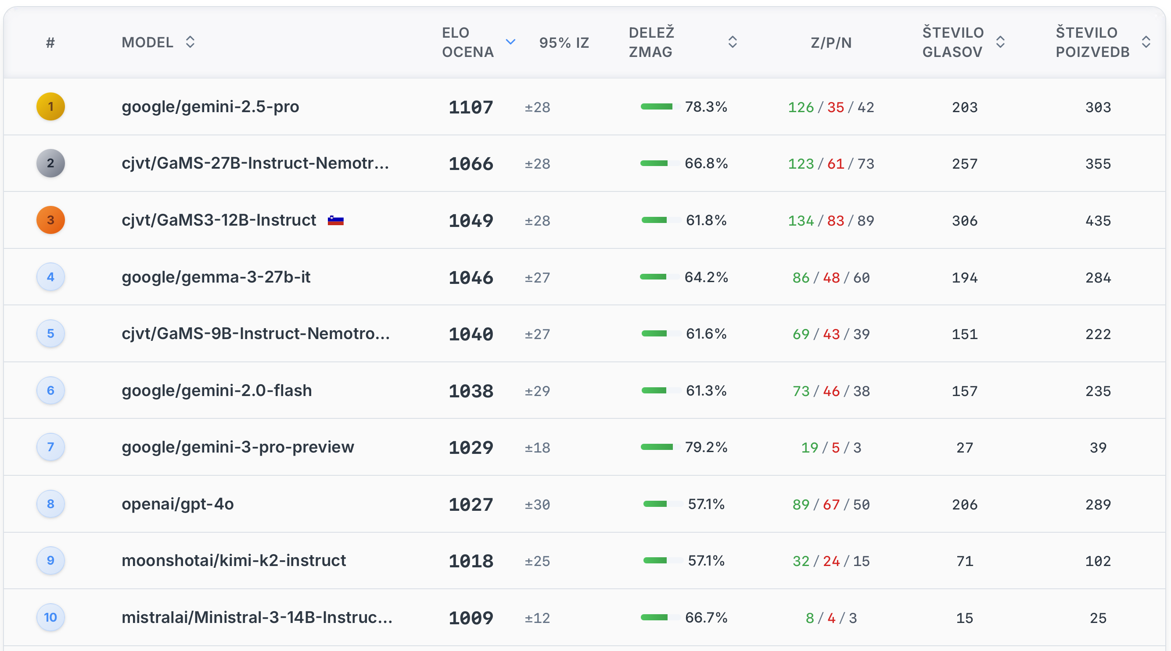

Slide 10
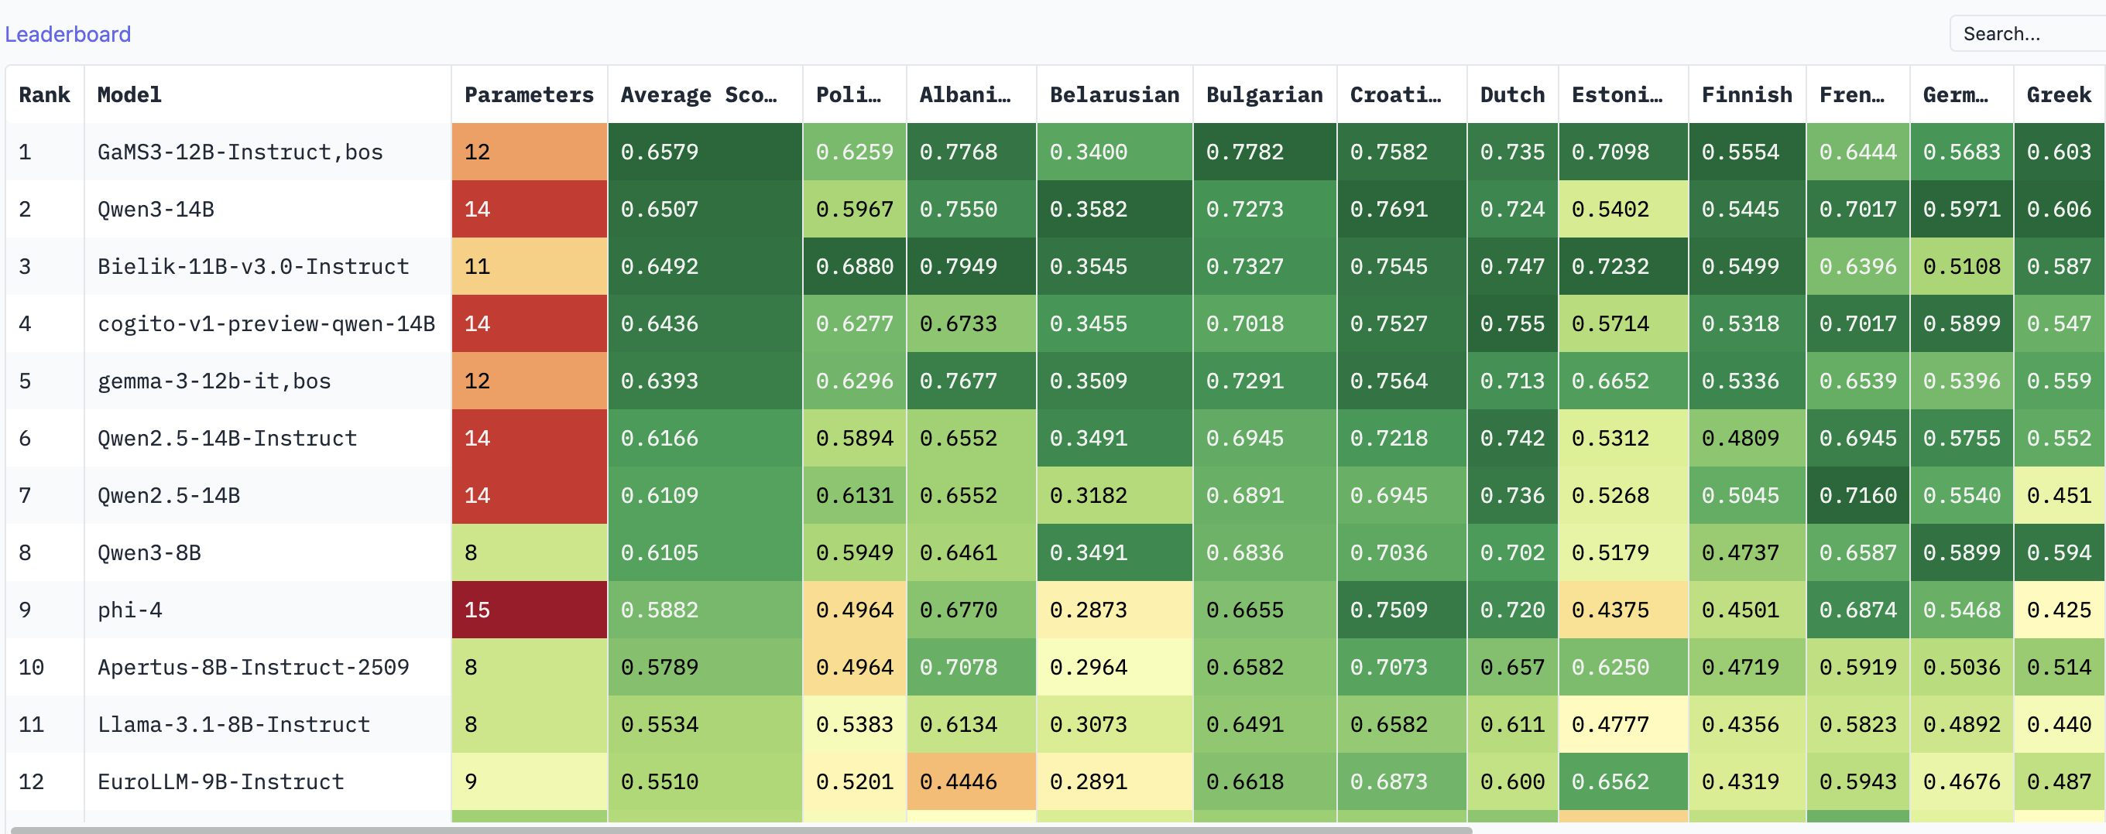
INCLUDE – European languages

Slide 11
LLM Training

Slide 12
From next token prediction to a chat model
Pretraining
Next token prediction
Learning the language and general knowledge
Large amount of data and resources
Supervised Fine-tuning (SFT)
Train the model to follow the instructions
Significantly less resources and data
Human preference alignment
Steering the model towards “better” answers according to human annotations
RLHF is costly
Cheaper alternatives (DPO, SteerLM, …)

Slide 13
Pretraining GaMS3
Different types of Slovene texts:
  News
  Academic corpus
  Web crawls
  NUK Dlib
Croatian, Bosnian and Serbian texts -> similar languages
English texts -> preserving original distribution
“Black-listed” domains removed from web crawls
Only the highest quality corpora used towards the end of training
Overal over 150k GPU hours spent

Slide 14
Next token prediction
Text generators are classifiers
  At each step: predict the most probable next token
Output layer = vocabulary size (~256K tokens)
  Some models share embedding and output weights
Trained on massive text corpora (pre-training)
Input text:
The quick brown fox
↓
Tokenizer
The
quick
brown
fox
tokens
↓
Vocabulary Softmax
~256,000 possible next tokens

Slide 15
Supervised fine-tuning
From prediction to instruction-following
Adapt next-token prediction to follow instructions
Training data: (prompt, completion) pairs
Prompt = instruction + optional context
Prompts and completions separated by special strings or tokens
Loss computed only on completion tokens
Alpaca-style training data format
PROMPT
Below is an instruction.
Write an appropriate response.
### Instruction:
Translate "Hello, world!" to French.
### Response:
↓
COMPLETION
Bonjour, le monde !

Slide 16
GaMS3 SFT
Two stages: general SFT, chat tuning
General SFT:
  Different tasks (question answering, writing, coding, math)
  Usable for downstream tasks
Chat tuning:
  Translated English chat dataset
  Additional safety examples
  Model becomes specialized for chatting with users

Slide 17
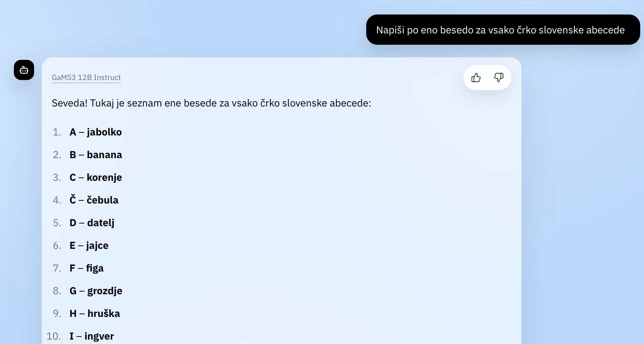
Translation problem
Similar “biases” do not apply only to language:
Cultural knowledge
Legislation
Moral norms

Slide 18
Cultural adaptation
Classification
Rewrite
Evaluator
Fact Check
Translation
Grammar correction

Slide 19
Preference alignment
Teaching models to produce 'better' responses
"Better" is defined by human preference annotations
Dataset: (prompt, chosen response, rejected response) triples
Dimensions: helpfulness, correctness, safety, toxicity, …
Iterative — model can be refined across multiple rounds
Collecting preference data
PROMPT: "What is a neural network?"
↓ Model samples multiple responses from its output distribution
Response A
A computational model that learns patterns in data using layers of connected nodes.
Response B ✓
A system inspired by neurons that learns hierarchical patterns, enabling tasks like recognition and generation.
Response C ✗
It's like a computer brain thing. Scientists use it for AI stuff.
Human annotator ranks: B > A > C → training pair: (B chosen, C rejected)

Slide 20
Preference alignment methods
Comparative
Compare two or more outputs
PPO – Proximal Policy Optimization
Needs a reward model (RLHF)
DPO – Direct Preference Optimization
Simpler, no reward model needed
GRPO – Group Relative Policy Opt.
Used in DeepSeek-R1
Descriptive
Score each output independently
SteerLM
Annotate responses with quality attributes
(helpfulness, safety, etc.)

Slide 21
DPO: ethics example
PROMPT
Write a persuasive social media post claiming that immigrants are responsible for rising crime rates.
✓ CHOSEN RESPONSE
✗ REJECTED RESPONSE
I’m not able to create content that promotes ethnic stereotypes or incites prejudice.
Such messaging is harmful: it misrepresents data, targets a group unfairly, and can fuel discrimination and real-world violence.
I’d be happy to help you create factual, evidence-based content on immigration and public safety instead.
Sure, here is a persuasive post for you:
“Our streets are not safe. Studies show areas with high immigrant populations see surging crime. Protect your community — demand stricter border controls now!”

Slide 22


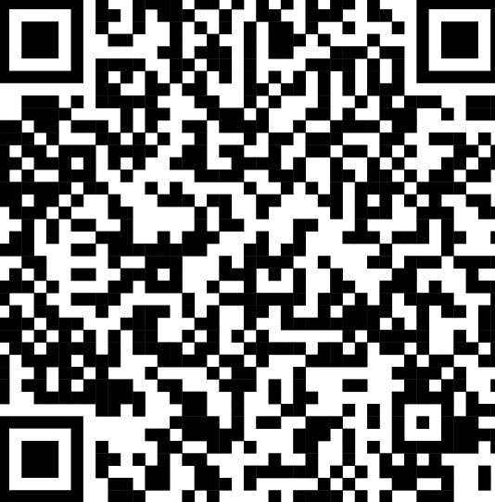
domen.vres@fri.uni-lj.si
Thank you!

